Slide 1
Old Chinese type A/type B in areal perspective
Marc Miyake, British Museum
5 November 2015
Recent Advances in Old Chinese Phonology
Beyond Boundaries

Slide 2
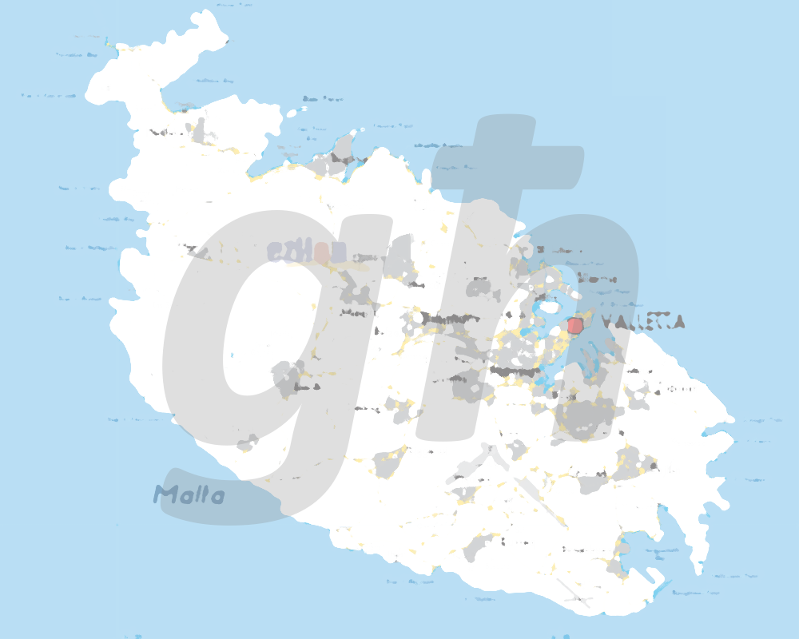
Part 1: The Maltese key
The background is a modification of a file by Alecastorina93 licensed under the Creative Commons Attribution-Share Alike 3.0 Unported license.

Slide 3
The Karlgrenian consensus Old Chinese had two kinds of syllables
Type A:
without *-j-
*ka
Type B:
with *-j-
*kja

Slide 4
The Pulleyblank revolution (1962) Old Chinese had two kinds of syllables
Type A:
short vowels
*ka
Type B:
long vowels
*kaa

Slide 5
Other interpretations of types A and B
Jaxontov (1965): absence vs. presence of voiced prefix
Type A ka vs. type B *d-ka
Pulleyblank (1973): accent on second vs. first mora
Type A ká vs. type B *kà
Zhengzhang (1987) & Starostin (1989): long vs. short vowel
Type A kaa vs. type B *ka
Reverse of Pulleyblank (1962)!
Ferlus (reported in Sagart 1999): complex vs. simple initial
Type A *C.ka vs. type B *ka

Slide 6
Norman’s emphatic theory (1994) Old Chinese had three kinds of syllables
Type A:
pharyngealized
consonants
*kˁa
Type B:
plain
consonants
*ka

Slide 7
Did you notice I wrote “three” and not “two”?
I left out Norman’s third type of syllable: retroflex.
Norman called retroflex syllables type B and plain syllables type C:
A *kˁa : B *kra : C *ka
pharyngealized : retroflex : plain

Slide 8
Is the retroflex category really necessary?
Norman’s “type B” …
*kra
… corresponds to type A and B syllables in other systems.
*kra A vs. *kra B
Type A and B syllables with *-r- undergo special developments that I won’t go into here.

Slide 9
My other problems with Norman (1994) in 1995
Norman wrote,
“all Early [i.e., Old] Chinese syllables developed a palatal medial (or yod) [i.e., *-j-] along with a palatalized initial and generally a more palatal vowel, unless this process was somehow impeded”
... by a pharyngealized consonant:
*ka > *kja but *kˁa > *ka
He drew parallels with Arabic. Arabic!? Without a specific example.
What good could these parallels be if almost all that palatalization never occurred (as Pulleyblank had been arguing for years)?

Slide 10
Years of uncertainty
I was almost entirely agnostic about the type A/B distinction.
But at least I was certain that it did not involve *-j-.
I was not convinced by either version of the vowel length hypothesis.
They conflicted with Chinese transcriptions of Indic languages with vowel length.
They conflicted with Sinospheric phonological typology. (I know of no Sinitic-type language which has a short vs. long vowel distinction in nonreduced open syllables.)
But apart from those two caveats, I had no idea.

Slide 11
The Schuessler shakeup
In 2000, Wolfgang Behr gave me a copy of Axel Schuessler’s unpublished manuscript on Later Han Chinese (which I will call Late Old Chinese).
Until then I was accustomed to the complex vowel changes of Starostin’s Late Old Chinese reconstruction. So complex I wrote a list for myself to try to keep track of them.
But I instantly understood Schuessler’s vowel changes!

Slide 12
Schuessler’s vowel bending So simple I instantly memorized it
(What follows is my further simplification.)
Before Late Old Chinese: just six vowels
high series: *i *ə *u
vs.
low series *e *a *o

Slide 13
Type A syllables: high series vowels bend into closing diphthongs
*i > *ei
*ə > *əɨ
*u > *ou
Low series vowels *e *a *o
stay low.

Slide 14
Type B syllables: low series vowels bend into opening diphthongs
*e > *ie
*a > *ɨa
*o > *uo
High series vowels *i *ə *u
stay high.

Slide 15
Older northern vs. newer southern bending
Schuessler-type
Late Old Chinese
Khmer:
Type A = *voiceless, type B = *voiced
Type A *ki > *kei
Type A *ku > *kou
Type B *ka > *kɨa
(> Middle Chinese *kɨə)
Type A *ki > kəj
Type A *ku > kou
Type B *ga > kiə

Slide 16
What …
… bent high series type A vowels down: e.g., *i > *ei?
… bent low series type B vowels up: e.g., *o > *uo?

Slide 17
The Maltese moment
Maltese ‘type A’: high vowels bent down:
‘silent’ għ < pharyngeal *ʕ, uvular *ʁ
Maltese ‘type B’: low vowel bent up
*ʕi > għi [eˁj] ~ [aˁj]
cf. Old Chinese *i > *ei (> *ai)
*ʕi > għu [oˁw] ~ [aˁw]
cf. Old Chinese *u > *ou (> *au)
kitāb > ktieb ‘book’
bāb > bieb ‘door’
cf. Old Chinese *a > *ɨa
Norman mentioned the imāla phenomenon in Arabic. At last I saw what it looked like!

Slide 18
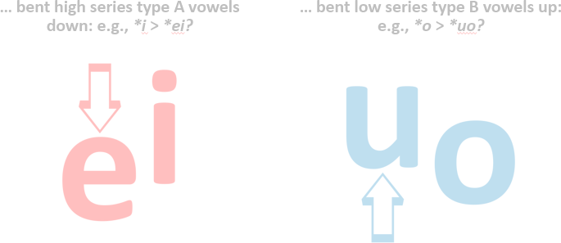
None of that should have surprised me, because Arabic imāla means … ‘bending’!
إمالة

Slide 19
So type A was characterized by pharygealization (‘emphasis’). But was it always that way?

Slide 20
Part 2: Through the bieb types A and B in areal perspective

Slide 21
Norman 1994 (emphasis mine)
“Some kind of division of words into two series, one of which is characterized by palatalization and the other by velarization or pharyngealization is a common phenomenon all over the Eurasian continent”

Slide 22
Baxter and Sagart’s “typologically unusual” system of 36 type A (emphatic) consonants
*pˁ- *pʰˁ-, *bˁ-, *mˁ-, *m̥ˁ-
*tˁ- *tʰˁ-, *dˁ-, *nˁ-, *n̥ˁ- tsˁ- *tsʰˁ-, *dzˁ-, *sˁ-
*lˁ- *l̥ˁ-, *rˁ-, *r̥ˁ-
*kˁ- *kʰˁ-, *gˁ-, *nˁ-, *n̥ˁ- *kʷˁ- *kʷʰˁ-, *gʷˁ-, *nˁ-, *n̥ˁ-
*qˁ- *qʰˁ-, *ɢˁ- *qʷˁ- *qʷʰˁ-, *ɢʷˁ-
*ʔˁ-, *ʔʷˁ-
All have type B (nonemphatic) counterparts except for the rare *ʔʷˁ-.
I do not know of any language with more emphatics than nonemphatics.
But I do know of languages with similarly structured consonant inventories.

Slide 23
Cairene Arabic (Youssef 2006)
23 emphatic (type A) consonants including some not in Baxter and Sagart’s Old Chinese: [fˁ vˁ wˁ zˁ ʃˁ ʒˁ xˁ ɣˁ ħˁ ʕˁ (sic!) hˁ]
Is there a real phonetic distinction between nonemphatic / nonpharyngealized pharygeals (sic!) [ħ ʕ] and emphatic / pharyngealized pharyngeals (sic!) [hˁ ʕˁ]?
Near-total symmetry like Baxter and Sagart’s Old Chinese
All emphatic consonants have nonemphatic counterparts
The only nonemphatic consonant without an emphatic counterpart is [q] (which behaves like an emphatic consonant before [ɑˁ]
BUT most emphatics are allophones of nonemphatics, not phonemes
Only /tˁ dˁ sˁ zˁ rˁ/ are phonemes

Slide 24
Russian
Near-total symmetry of
nonpalatalized (Norman: pharyngealized; type A) and
palatalized (≅ type B) consonants
like Baxter and Sagart’s Old Chinese
Most pairs are phonemes (unlike Cairene Arabic but like Baxter and Sagart’s Old Chinese)
BUT the Russian distinction involves palatalization and the Old Chinese distinction generally does not
Some type B syllables palatalized in Late Old Chinese, but certainly not most

Slide 25
A bit closer in time and space to Old Chinese: Old Turkic (8th c. AD)
The runic script for Old Turkic has two series of consonants, one for back vowels (≅ type A) and another for front vowels (≅ type B): e.g.,
back 𐰴 <q> vs. front 𐰚 <k>
The phonetic opposition may have been closer to that of Russian rather than Old Chinese
though Russian doesn’t have /q/ or even [q] or even /k/ vs. /kʲ/
The two series are nearly symmetrical
There are some neutral consonant characters: e.g., 𐰢 <m>
BUT there is no phonemic opposition between the two series

Slide 26
Cairene Arabic, Russian, and Old Turkic demonstrate that a large paired consonant system like Baxter and Sagart’s is possible

Slide 27
However, in all three cases, a large system derives diachronically or synchronically from a system with fewer or even no pairs
Only 5 of the 23 Cairene emphatic consonants are phonemic; only 7 emphatic (here, ejective) consonants can be reconstructed for Proto-Afroasiatic (*p’*t’ *tl’ *s’ *c’*k’*kʷ’) (Ehret 1995)
Although palatalization is currently phonemic in Russian, it was once predictable in early Slavic until short front vowels conditioning it were lost
Backness/frontness of Old Turkic consonants can be predicted: no pairs like /qa/ vs. /ka/ (unlike Baxter and Sagart’s Old Chinese)

Slide 28
Is the Old Chinese consonant system also derived from an earlier system with fewer or even no pairs?

Slide 29
Was the 36-emphatic system of Old Chinese a short-lived stage that was too large to last?
My three-stage hypothesis:
Early Old Chinese: Few or no emphatics; emphasis predictable on the basis of factor X.
Middle Old Chinese: Factor X is partly or wholly gone, so emphasis is no longer predictable and is now phonemic. Bent vowel allophones develop after consonants.
Late Old Chinese: Emphasis in consonants is partly or wholly gone, so bent vowel allophones are no longer predictable and are now phonemic.

Slide 30
What was factor X?
There is an undeniable trend toward reduction in the region
Baxter and Sagart’s Old Chinese is sequisyllabic:
*Cə.C(r)V(C)(ʔ/s) with only one possible vowel (*ə) in presyllables before main syllables
Modern Chinese is ‘monosyllabic’
Chinese-style reduction can also be found in Kra-Dai, Hmong-Mien, Vietic, and even Chamic

Slide 31
What was factor X?
Given that the locus of emphasis was the initial consonant of the main syllable, factor X must have been close to the initial consonant

Slide 32
What was factor X?
What if emphatics are traces of lost vocalic distinctions in presyllables which are right before initials?

Slide 33
Emphatics as a step in the progression between disyllables and monosyllables

Slide 34
Early Old Chinese
Full first syllables of disyllables reduced to presyllables with only two possible vowels
low vowels condition type A
*Ce, *Ca, *Co > *Că +emphasis
high vowels condition type B
*Ci, *Cə, *Cu > *Cɨ̆

Slide 35
Middle Old Chinese
Presyllabic vowels neutralized
to schwa or lost entirely
*Că > *(C(ə))-CˁV
*Cɨ̆ - > *(C(ə))-CV

Slide 36
Why did low vowels condition emphasis?
Pulleyblank (1997) and Operstein (2010) regarded low [ɑ] as the syllabic form of a pharyngeal glide
Low [ɑ] and [a] are syllabic allophones of pharyngeal /ʕ/ in Salish (Bessell 1992)
Low /ɑ/ conditions pharyngeal allophones of consonants in Cairene Arabic (Youssef 2014)

Slide 37
Low vowel-conditioned emphatic spreading mostly in accordance with areal trends

Slide 38
Low/high vowel systems
Tungusic
Koreanic (late and secondary)
Much of Mongolic
Khitan?
Nivkh (Gruzdeva 1998: 11)
Chukotko-Kamchatkan (Bobaljik 2009)

Slide 39
Harmony
Arabic (emphasis spreading)
Uralic (but palatal!)
‘Altaic’ (Tungusic and Koreanic low/high, but Turkic palatal and Mongolic transitional)
Nivkh (traces of low/high)
Chukotko-Kamchatkan (low/high)
Yukaghir (but palatal!; Maslova 2003: 35)
Lhasa Tibetan (low/high)
Ronghong Qiang (palatal/labial/rhotic; LaPolla & Huang 1996: 35-36)

Slide 40
What about original monosyllables?
1. Early Old Chinese: Emphasis absent; later allophonic
Low vowels: */Ce Ca Co/ High vowels: */Ci Cə Cu/
Later *[Cˁe Cˁa Cˁo]
2. Middle Old Chinese: Emphasis phonemic
Low vowels: */Cˁe Cˁa Cˁo/ High vowels: */Ci Cə Cu/
cf. Khalkha pharyngealized low series
3. Late Old Chinese: Emphasis lost
Low vowels: */Ce Ca Co/ High vowels: */Ci Cə Cu/

Slide 41
Emphatic harmony in disyllables like emphatic harmony in sesquisyllables on a larger scale
Type AA words:
蝴蝶 *gˁa lˁep ‘butterfly’
Type BB words:
麒麟 *gə rən ‘qilin’

Slide 42
Emphatic harmony in disyllables like emphatic harmony in sesquisyllables on a larger scale
Harmony in reduplication:
AA: 邂逅 *gˁres gˁros ‘carefree’
BB: 蟋蟀 *srit srut ‘cricket’
See Miyake 2008 for statistics

Slide 43
Disyllables without emphatic harmony
Type AB and BA words less common
opaque compounds and/or loanwords?
e.g., 鳳凰 *N-prəm-s ɢʷˁaŋ ‘fabulous bird’ < 風皇 ‘wind sovereign’ with affixes?

Slide 44
Some problems for my ‘extended emphatic theory’

Slide 45
Some problems for my ‘extended emphatic theory’
Why do my reconstructed low vowels sometimes correspond to high vowels of potentially related forms in Austronesian: e.g., my Early Old Chinese 腦 *Cănuʔ : Proto-Austronesian *punuq ‘brain’?
Ad hoc solution: an earlier form of this inherited?/ areal? word was *ponuq; *o lowered in Chinese but raised in Proto-Austronesian (which had no *o)?

Slide 46
Some problems for my ‘extended emphatic theory’
Determining original vowels (if any) of prefixes
*Ce- *Ca- *Co-?
*Ci- *Cə- *Cu-?

Slide 47
Some problems for my ‘extended emphatic theory’
Explaining type A/B doublets:
e.g., 髀 *m-pˁeʔ ~ *peʔ ‘femur’ from *m-peʔ and *mɨ̆-pe with variants of a body part prefix *mɨ̆-?

Slide 48
Extending my ‘extended emphatic theory’?
Did Tangut also have a type A/B distinction, and if it did, did it originate in the same way?

Slide 49
Questions?

